Slide 1
CourseSphere: Learning Management System
Phase I – Project Presentation
ISTE.240.602
Srivignan Saravanan - 421006512 Muhammed Safnas - 751008813 Yazan Ghawi - 744000192

Slide 2

What is CourseSphere?
A Learning Management System (LMS) inspired by platforms like Coursera
Focused on free online courses
Users can browse courses, enroll, learn through lessons, complete quizzes, track progress, and earn certificates
Target Users
Students / Learners
Instructors
Administrator

Slide 3
Scope & Key Features
In Scope
Course catalog with search & filters
Course enrollment and access
Lessons with text, video, and audio
Quizzes and progress tracking
Course completion certificates
Instructor & admin dashboards
Out of Scope
Paid subscriptions
Live video streaming
Advanced proctored exams

Slide 4
User Interaction Scenarios
Student
Registers → enrolls in a course
Studies lessons → completes quizzes
Tracks progress → earns certificate
Instructor
Creates and manages courses
Uploads lessons and quizzes
Views enrollments
Admin
Manages users and roles
Approves courses
Oversees platform content

Slide 5
Technical Implementation
Technologies Used
Backend: Spring Boot (MVC)
Database: MySQL
Frontend: HTML, CSS, JavaScript
UI Framework: Bootstrap or Tailwind
Authentication: Session-based login
Architecture
MVC structure
Persistent database with JPA
Server-rendered pages with dynamic data

Slide 6
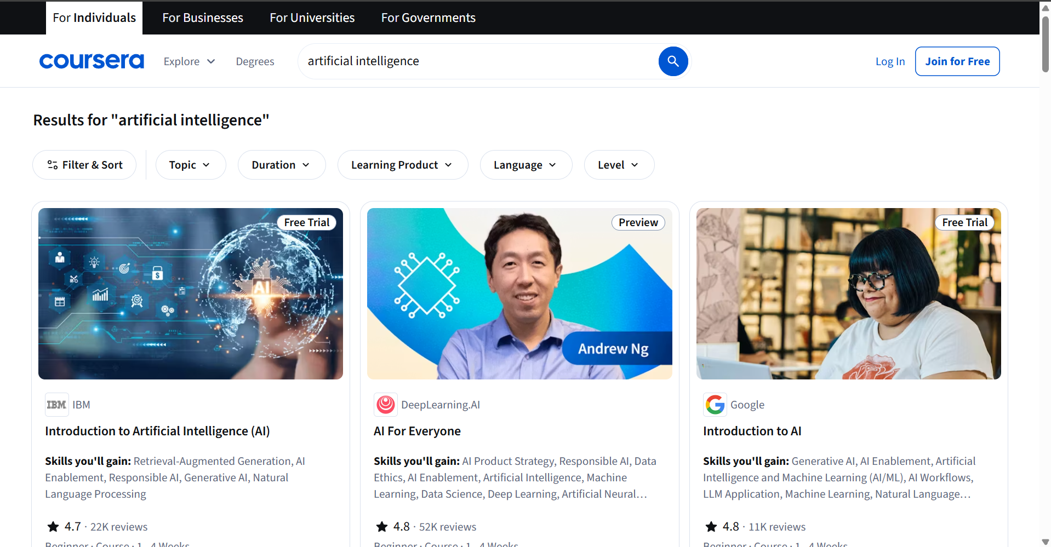
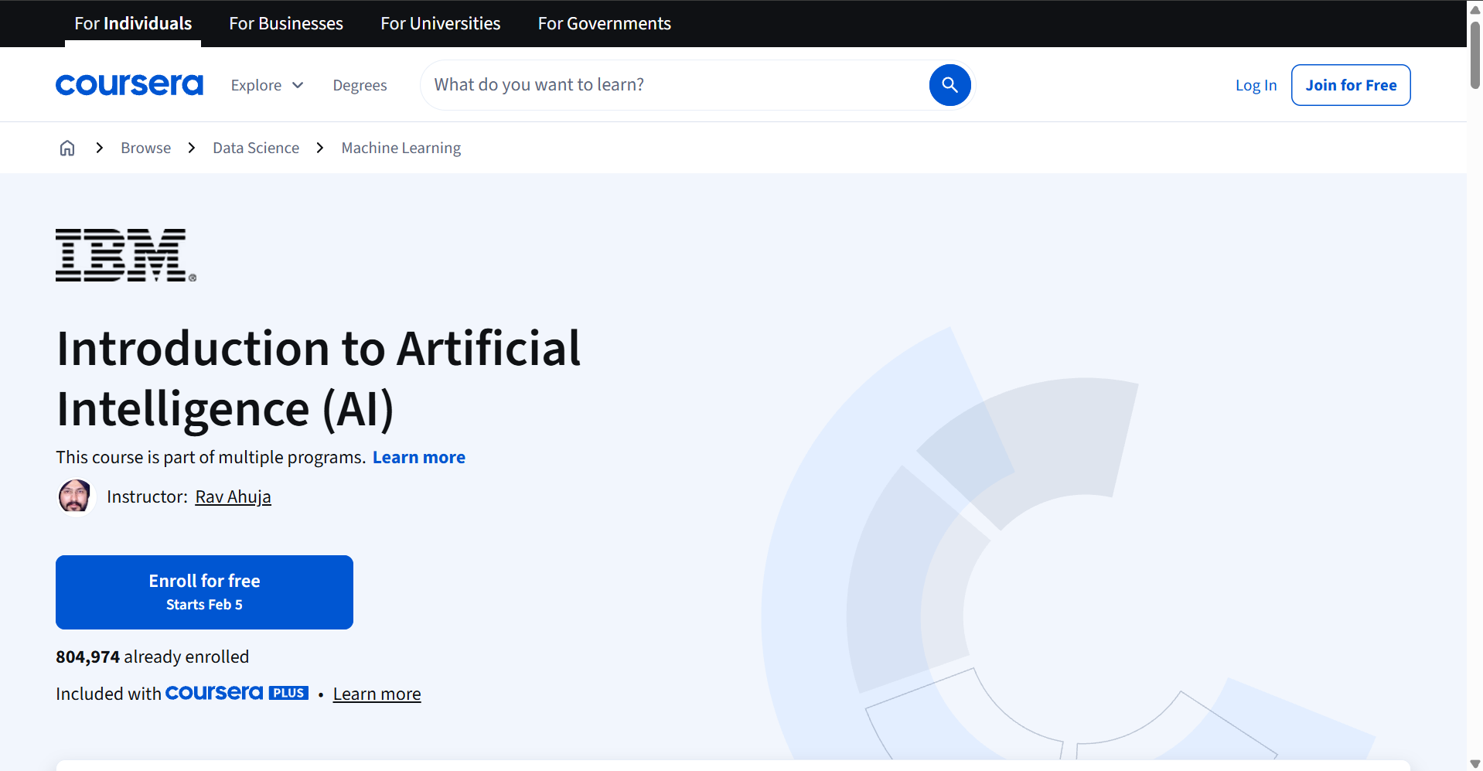
UX/UI & Challenges
UX/UI Decisions
Sidebar navigation for courses
Course cards for browsing
Responsive layout
Separate dashboards per role
Challenges & Mitigation
Complex database → early schema design
Role management → controller-level checks
Quiz logic → start simple, extend later

Slide 7
CourseSphere.

